Slide 1
LCD Bluetooth

Slide 2
Tools Needed
Note Book
Laptop
Arduino Uno
Bluetooth
LCD 16*2
10k ohm potentiometer
Breadboard x1
220 Ohm x2
Jumper Cable

Slide 3
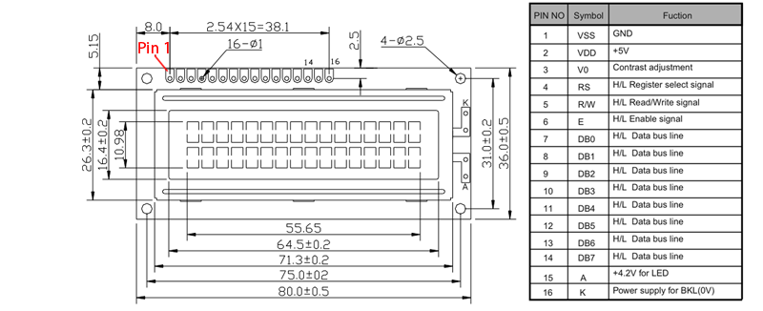
LCD

Slide 4
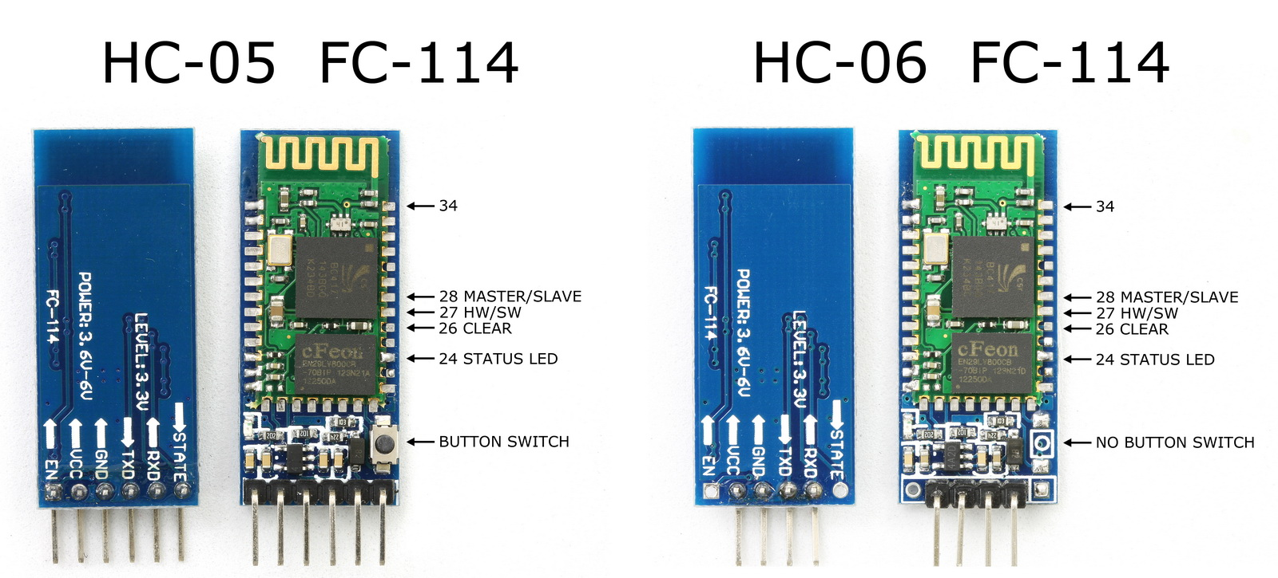
Bluetooth

Slide 5
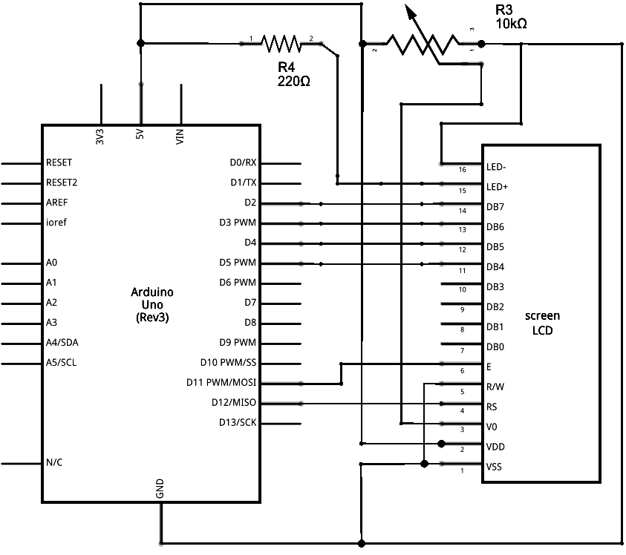
Our Circuit

Slide 6
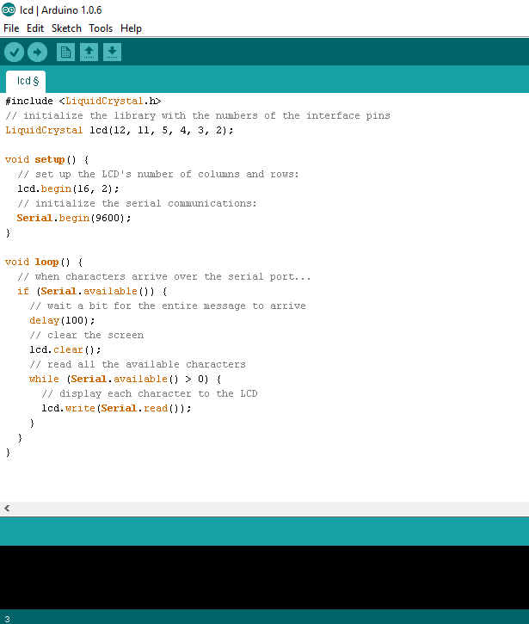
Code

Slide 7
Conclusion
It’s just idea to build application .
Feel free to ask .
Using of Electronics Component.
Design Circuit .
Using Arduino.
Programming .

